Slide 1
868 Park Ave.
Commission Proposal

Slide 2
Stairwell Concepts
1. Analgous colors
2. Complimentary colors

Slide 3
Option 1
Analogous colors to home color palette
30” x 20”
Contemporary style, expressive marks
Layered plexi glass ( see next page for examples)
or on wood panel
* Please mind that this is just a sketch, the finished painting would be more polished and defined.

Slide 4
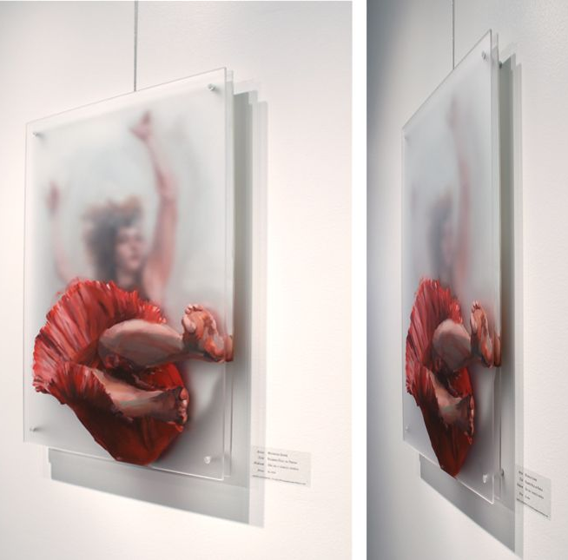
Option 1 Inspiration
Layered Plexi
Layered Plexi
Color Palette

Slide 5
Option 2
Complimentary colors to home color palette
36” x 36”
Realistic illustrative style
Oil on wood panel

Slide 6
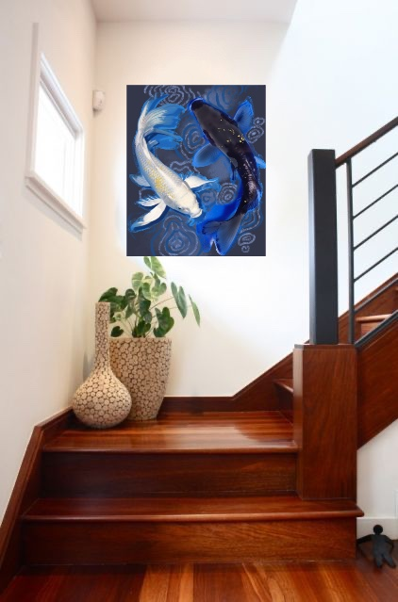
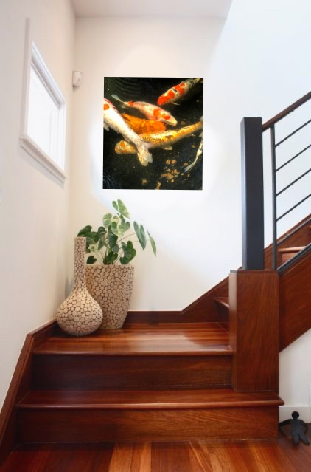
In Home Examples

Slide 7
Koi is a homophone for another word that means “affection” or “love” in Japanese; koi are symbols of love and friendship in Japan.

Slide 8
Bedroom Paintings
Pop of color
Organic shapes
Natural Elements

Slide 9
Option 1
Miami Summer Nights
Moody deep blues and greens
Pops of orange and magenta
Painterly style with expressive marks
24” x 48”
Oil on wood panel
Notes:
(These don’t have designer IDs since they were based off the default master slides already in the deck.

Slide 10
Option 2
Flamboyance
A group of Flamingos is called a Flamboyance
Bold pop of color
Realistic illustrative style
24” x 48”
Oil on wood panel
Notes:
(These don’t have designer IDs since they were based off the default master slides already in the deck.

Slide 11
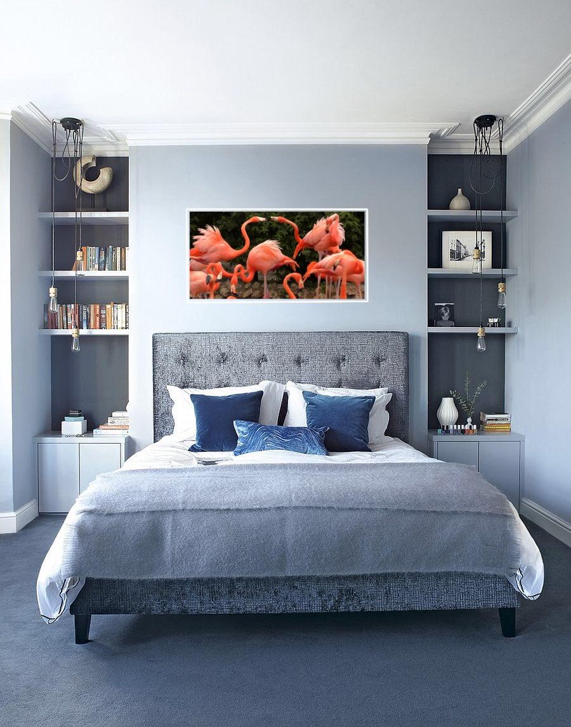
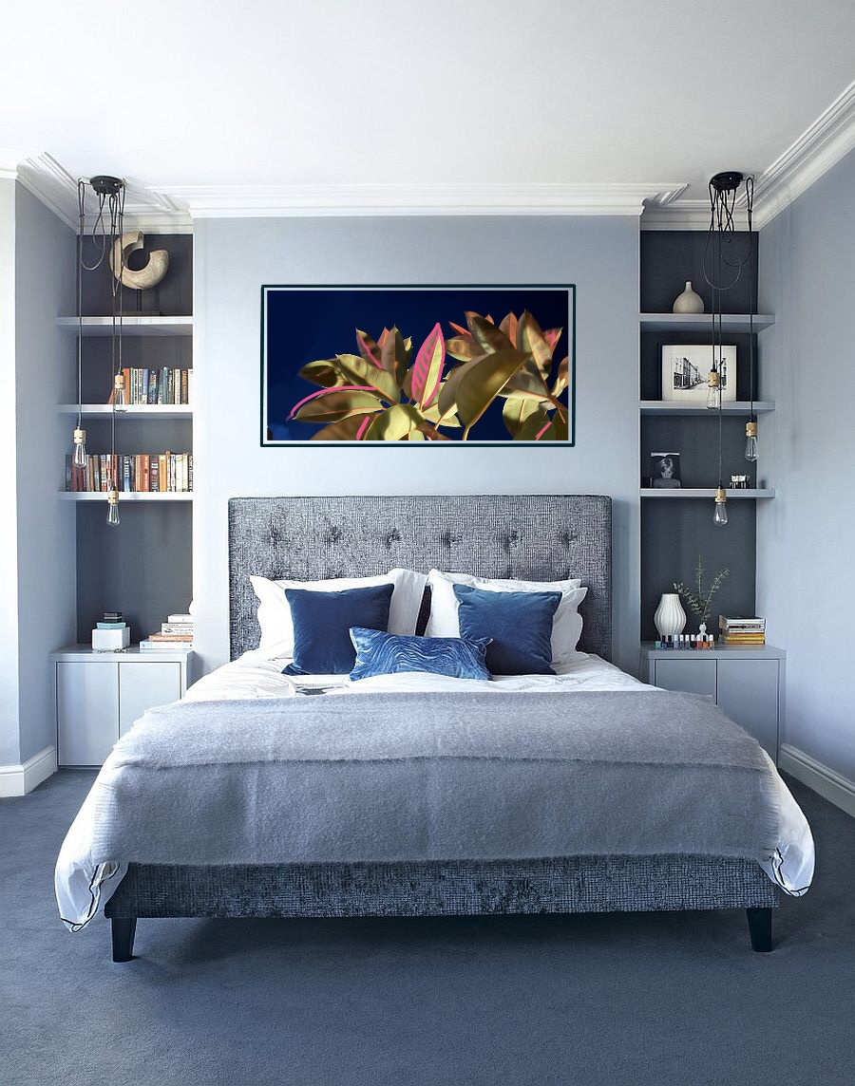
In Home Examples

Slide 12
Thank you!
Please let me know if you have any questions or would like to make any adjustments to the options
gsearts@gmail.com

